Slide 1
UNIT III
Exception

Slide 2
CONTENTS
Exceptions in Python
Handling Exceptions: try block, except block, else block, finally block
Raising an exception
User defined exception
Assertions
Object Oriented Programming
Classes: defining classes with _init_() and methods
Creating objects, class variables and instance variables
Inheritance _super() function

Slide 3
EXCEPTIONS IN PYTHON
An exception is an event which occurs during the execution of a program that disrupts the normal flow of the program’s instructions.
Python provides two important features to handle exceptions:
(i) Exception Handling
(ii) Assertions

Slide 4
COMMON EXCEPTIONS
ZeroDivisionError: Occurs when a number is divided by zero
NameError: Occurs when a name is not found
IndentationError: Incorrect Indentation
IOError: Occurs when Input Output operation fails
EOFError: Occurs when end of file is reached and yet operations are being performed

Slide 5
HANDLING EXCEPTIONS: TRY BLOCK, EXCEPT BLOCK, ELSE BLOCK, FINALLY BLOCK
try Block
Contains one or more statements which encounters exception
except Block
Handles the cause of the exception appropriately
else Block
Executes if the try Block is exception free
finally Block
Consists of statements which are executed regardless of an exception in try Block

Slide 6
SYNTAX
try:
#Run this code
except:
#Run this code if an exception occurs
else:
#Run this code if no exception occurs
finally:
#Always run this code

Slide 7
EXAMPLE
try:
print("try block")
x=int(input('Enter a number: '))
y=int(input('Enter another number: '))
z=x/y
except ZeroDivisionError:
print("except ZeroDivisionError block")
print("Division by 0 not accepted")
else:
print("else block")
print("Division = ", z)
finally:
print("finally block")
x=0
y=0
print ("Out of try, except, else and finally blocks." )

Slide 8
OUTPUT
try block
Enter a number: 10
Enter another number: 2
else block
Division = 5.0
finally block
Out of try, except, else and finally blocks.

Slide 9
RAISING AN EXCEPTION
Exceptions can be raised using “raise” statement
Used to throw exceptions
Usually done for error-checking
The general syntax for the raise statement:
raise [Exception [, args [, traceback]]]
Exception-type of exception
args- optional value for exception argument
traceback- optional, this object is used for exception

Slide 10
Contd…
“raise” keyword is used to signal exceptional situation to the normal flow of program
x=5
if x <10:
raise ValueError(‘x should not be less than 10’)
Output:
Traceback (most recent call last):
File “C:/Python34/Scripts/raise1.py”, in line 3, in <module>
raise ValueError(‘x should not be less than 10’)
ValueError: x should not be less than 10

Slide 11
EXAMPLE
try:
raise ValueError
except ValueError:
print(‘There was an exception’)
Output:
There was an exception

Slide 12
USER DEFINED EXCEPTION
Create own exceptions by creating new exception class.
In Python, users can define custom exceptions by creating a new class.
This exception class has to be derived, either directly or indirectly, from the built-in Exception class.
Most of the built-in exceptions are also derived from this class.

Slide 13
EXAMPLE
#class MyError is derived from super class Exception
class MyError(Exception):
def _init_(self, value):
self.value= value
def _str_(self)
return(repr(self.value))
try:
raise(MyError(3*2))
except MyError as error:
print(‘A New Exception occurred’,error.value)
Output:
(‘A New Exception occurred’,6)

Slide 14
ASSERTIONS
Assertions are statements that assert or state a fact confidently in your program.
For example, while writing a division function, you're confident the divisor shouldn't be zero, you assert divisor is not equal to zero.
Assertions are simply boolean expressions that check if the conditions return true or not.
If it is true, the program does nothing and move to the next line of code. However, if it's false, the program stops and throws an error.

Slide 15
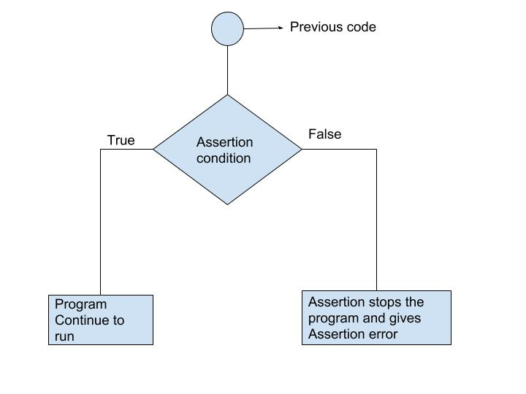
ASSERTIONS
Used when debugging the code
Carried out by the assert statement which contains assert keyword
Syntax for assert statement:
assert Expression[ , Arguments]

Slide 16
Contd…
Assertions are the conditions or boolean expressions which are always supposed to be true in code.
assert statement takes an expression and optional message.
assert statement is used to check types,values of argument and output of function
assert statement is used as debugging tool as it stops execution at the point where error occurs.

Slide 17
EXAMPLE
def avg(marks):
assert len(marks) != 0
return sum(marks)/len(marks)
mark1 = []
print("Average of mark1:",avg(mark1))

Slide 18
def avg(marks):
assert len(marks) != 0,"List is empty.“
return sum(marks)/len(marks)
mark2 = [55,88,78,90,79]
print("Average of mark2:",avg(mark2))
mark1 = []
print("Average of mark1:",avg(mark1))

Slide 19
OBJECT ORIENTED PROGRAMMING
Class : A user-defined prototype for an object that defines a set of attributes that characterize any object of the class.
The attributes are data members (class variables and instance variables) and methods, accessed via dot notation
Class Variable: A variable that is shared by all instances of a class. Class variables are defined within a class but outside any of the class's methods
Instance Variable: A variable that is defined inside a method and belongs only to the current instance of a class

Slide 20
Method − A special kind of function that is defined in a class definition.
Object − An object (instance) is an instantiation of a class. An object comprises both data members (class variables and instance variables) and methods.
Inheritance − The transfer of the characteristics of a class to other classes that are derived from it.
Function overloading − The assignment of more than one behavior to a particular function. The operation performed varies by the types of objects or arguments involved.

Slide 21
CLASSES: DEFINING CLASSES WITH _init_() AND METHODS
Classes can be defined using “class” statement
Name of class immediately follows keyword “class” followed by colon-
class ClassName:
‘Optional class documentation string’
class_suite

Slide 22
EXAMPLE
class Employee:
‘Common base class for employees’
empcount=0
def _init_(self, name, salary):
self.name = name
self.salary = salary
Employee.empcount +=1
def dispcount(self):
print “Total employee %d” %Employee.empcount
def disp(self):
print “Name: “, self.name, ”, Salary: “, self.salary

Slide 23
CREATING OBJECTS, CLASS VARIABLES AND INSTANCE VARIABLES
Objects:
emp1 = Employee(“Zara”, 2000)
“emp1” is an object and “Employee” is name of class
Class Variables- Defined within class construction
class Shark:
animal_type = “fish”
“animal_type” is class variable
Instance Variables- Defined within methods
class Shark:
def _init_(self,name,age):
self.name=name
self.age=age
“name”, “age” are instance variables

Slide 24
INHERITANCE super() FUNCTION
Inheritance- Transfer of properties from one
entity to another entity
super() function- Returns temporary object of
superclass that allows to
access methods of base
class

Slide 25
BENEFITS OF INHERITANCE
Code Reusability-We do not have to write the same code again and again
It represents a real world relationship between parent class and child class
It is transitive in nature-If a child class inherits properties from a parent class, then all other subclasses of the child class will also inherit the properties of the parent class.

Slide 26
PYTHON INHERITANCE SYNTAX
class Baseclass:
Body of base class
class Derivedclass(Baseclass):
Body of derived class

Slide 27
EXAMPLE
class Parent:
def func1(self):
print(“this is function1”)
class Child(Parent):
def func2(self):
super().func1()
print(“this is function2”)
Ob=Child()
Ob.func2()

